Slide 1
COVID-19 Heat Map Application (CHIMP)
By Jerum Hubbert
Notes:
Welcome to the CHIMP project. This project can be viewed at http://chimp-dev.s3-website-us-west-1.amazonaws.com/ and in a few weeks can be viewed at https://ww.cashchimp.net
This application was design to answer the need to get real data about the current COVID-19 global crisis. All data is provided by John Hopkins University via https://covid19api.com/ API.

Slide 2
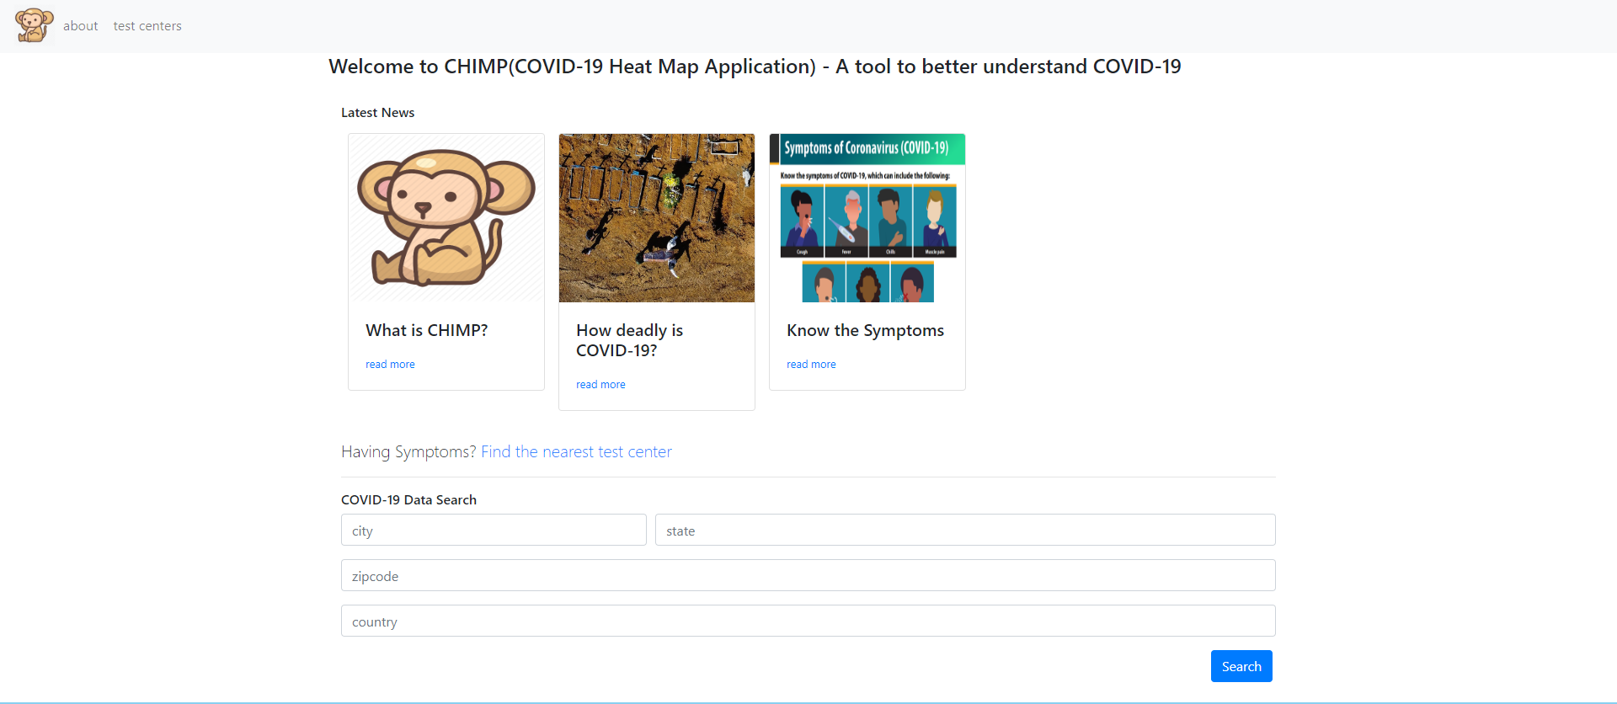
The landing page
News feeds
COVID-19 data search for your area!
Link to test center search.
Notes:
The news feed is intended to provide update to date news for what is going on with COVID-19.
The form at the bottom allows a user to see what is going on in their area.
As this is the landing page we link to every other page here.

Slide 3
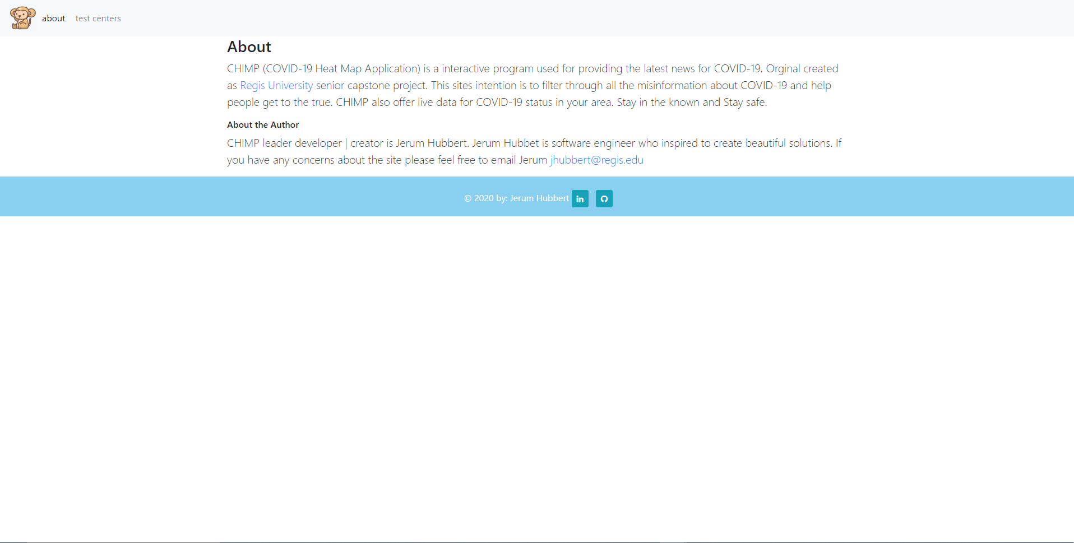
About
Notes:
The about page is used for reference just in case someone what to know more about the team.

Slide 4
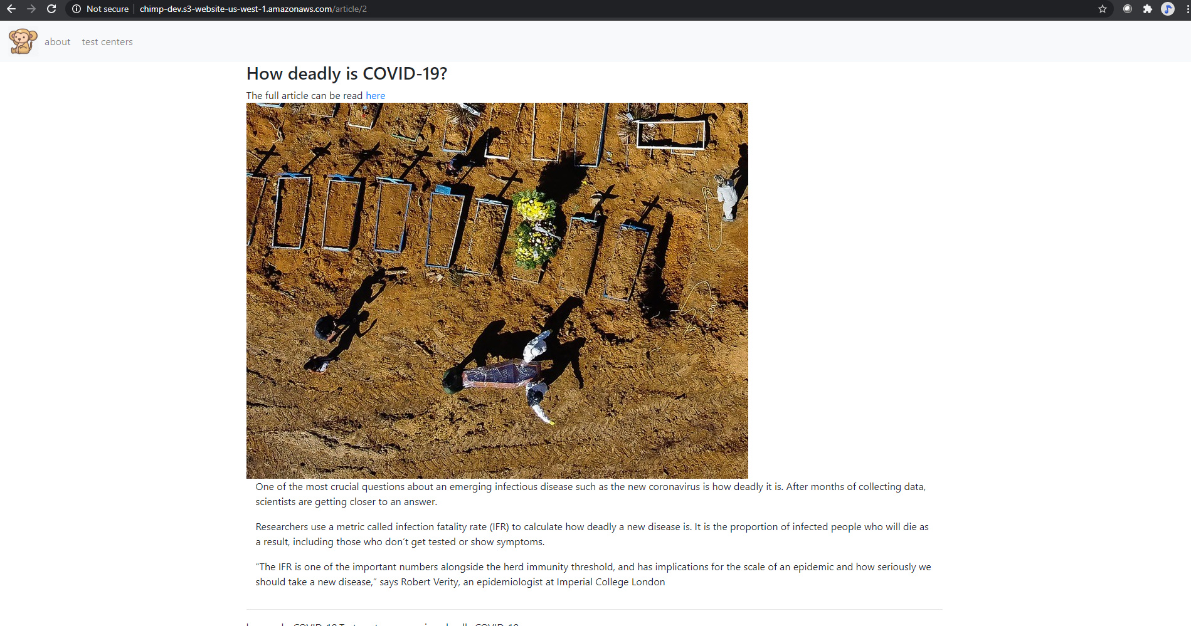
News details
Always current news
We only show what is important now.
Notes:
As discussed about this product is for showing the truth. We highlight articles we find on the web which done lie to you.

Slide 5
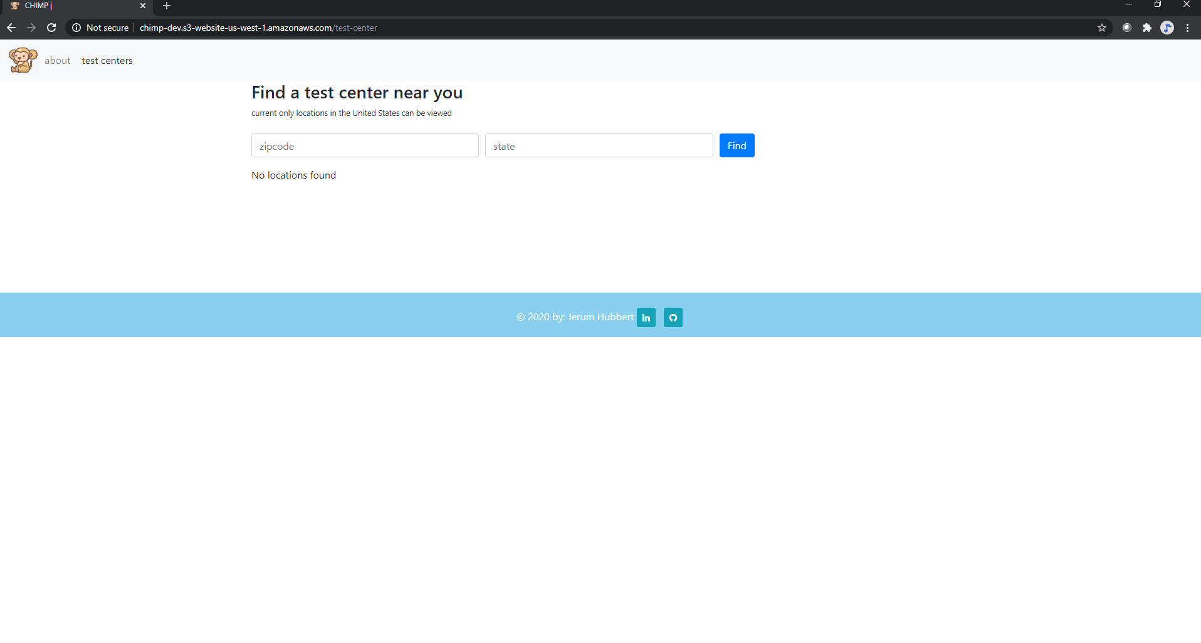
Find a test center
Zip code and State search.
Information is real time thanks to https://covid19api.com/
Notes:
This form searches test centers near you, currently this only works in the United States. A user places their zip and state in the form and a list of close center will appear under the form.

Slide 6
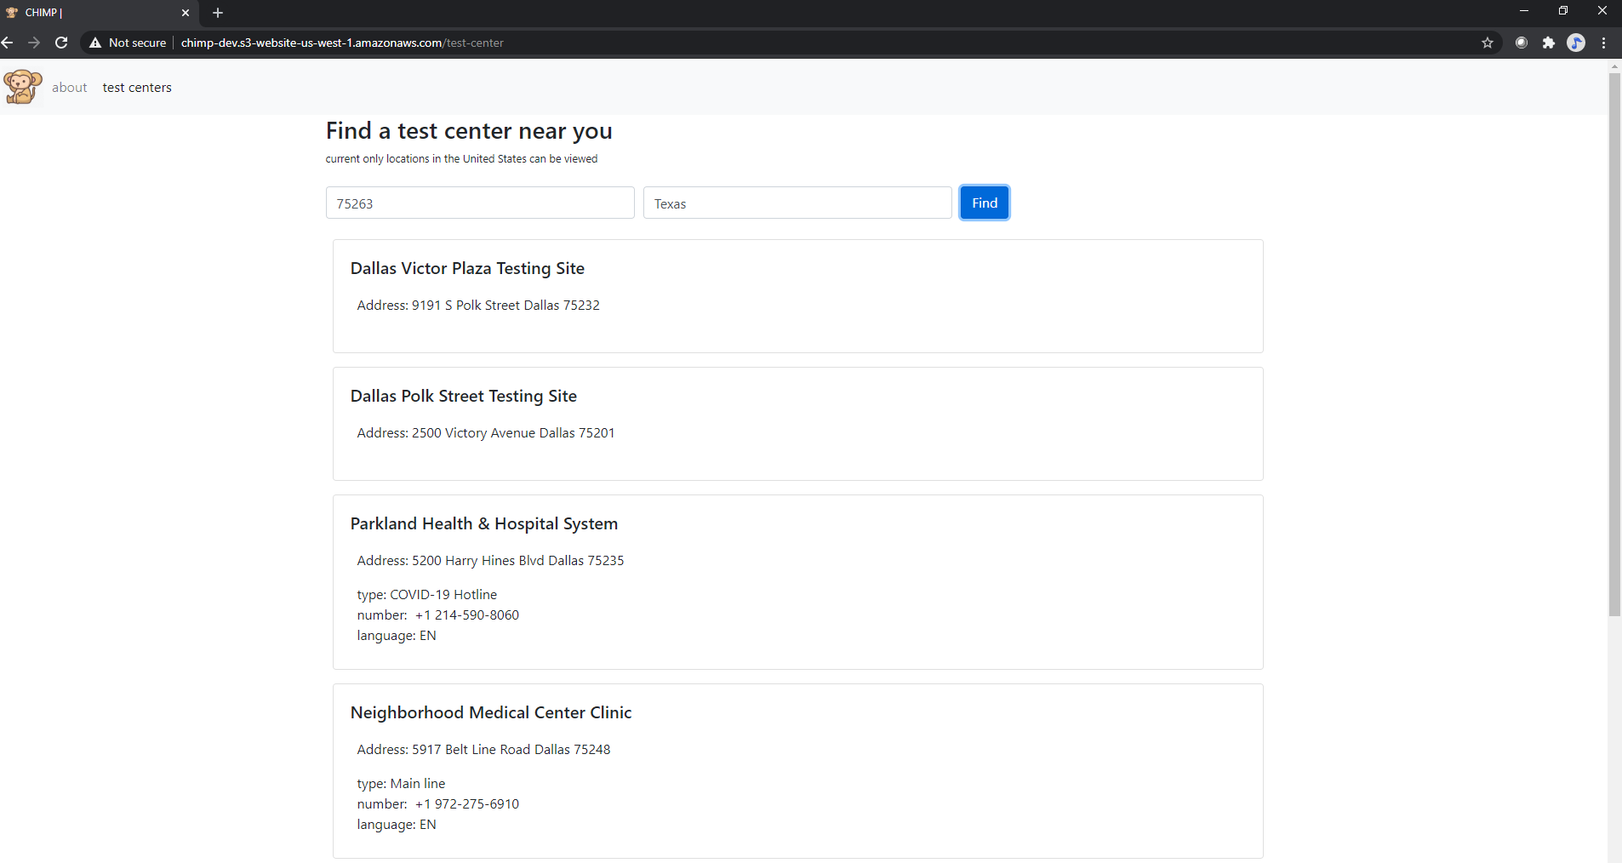
Result from a test center search
Notes:
This shows how the data for test centers are present to users. Each location can have several locations and numbers so some of the data can be rather long. This is all current and updated daily!

Slide 7
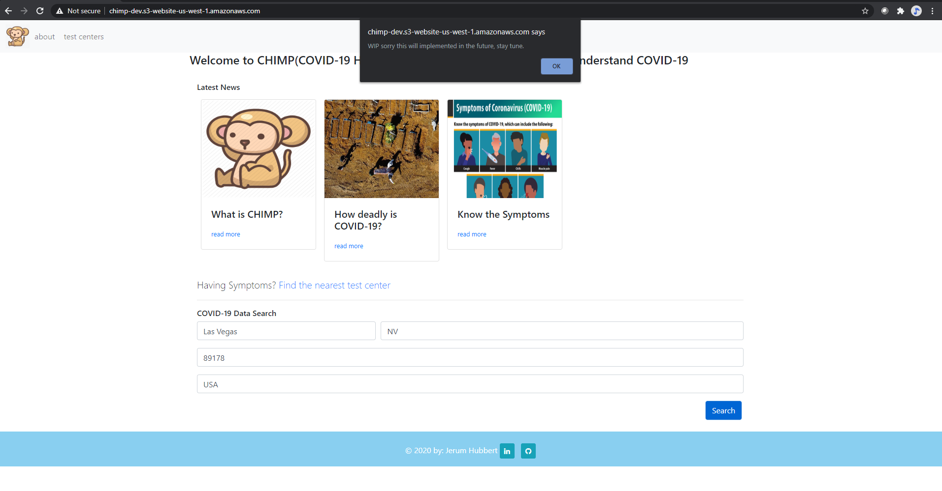
Heat Map
Allows a user to get current COVID-19 data for there area.
Current a Work in Progress. ETA July 5, 2020
Notes:
Once a person enters in their location information and searches. A new page will be displayed with a map of their area, The Heat Map. The map will show locations of hospitals and their current COVID-19 numbers. Detailed information about how many new cases, existing cases, and deaths will also be present on this page. Users will have the ability to drill down deeper from the information John Hopkins University has provided.

Slide 8
References
Redelinghuys, K. (2020). A free API for data on the Coronavirus. Retrieved from https://covid19api.com

